Slide 1
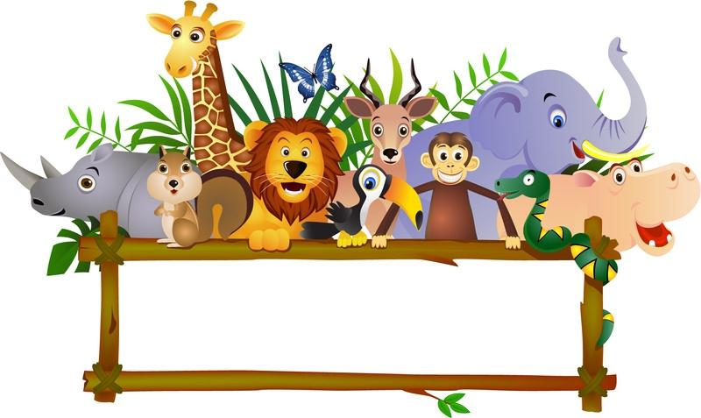
VIRTUAL ZOO

Slide 2
VIRTUAL REALITY PROJECT
TEAM MEMBERS:
Antoinette Attipoe
Gregory Jones
Kayode Onaollapo
May 8, 2012

Slide 3
Presentation Outline
Introduction
Goals & Objectives
Modeling
VRML Functionality
Designed Environment
Tools Used
Problems Encountered
Shortcomings
Recommendations
Screen Shots

Slide 4
Introduction
The virtual zoo will be:
An educational tool to teach children about animals.
Create interaction between the animals and the humans (sounds, movement, etc)
The virtual zoo can help children learn the names of the animals, their characteristics, their habitat and their behaviors.

Slide 5
Modeling
Modeling was done using 3ds Max software
Acquired 3d Models (of animals, landscape, people, etc) from different websites
3d Models were scaled so they could fit the zoo scenery

Slide 6
Modeling- Lighting & CAMERA
Used standard lighting (omni lights) to lighten the zoo environment
Target cameras were placed at different angles of each scene to capture the different view points of each animal exhibit

Slide 7
VRML Functionality
We used the VRML functionality in 3ds Max to create anchor sensors

Slide 8
Design Environment
The zoo had six layouts and nine different sections.
The sections are the:
Bird house
Petting farm
Reptile & amphibian house
Aquarium
Penguin exhibit
Ape House
Elephant house
Zoo entrance layout which housed the African savanna, small mammal house and the dinosaur exhibit
Rest area.

Slide 9
Tools Used
3ds Max 2011
VRMLPad
Cortona 3D player
Dell PC/Laptop

Slide 10
Problems Encountered
Having to learn how to use 3ds Max while working on the project
Scaling the 3d models was time consuming
Implementation of some of the functionalities like adding the sound of animals to the virtual zoo did not work

Slide 11
Shortcomings
Could not add more interaction (sound, movement, etc) to the virtual zoo

Slide 12
Recommendations
More exhibits and animals can be added to this virtual zoo
Sound and interactions can be added to this zoo

Slide 13
SCREEN SHOTS OF VIRTUAL ZOO IN 3DS MAX

Slide 14
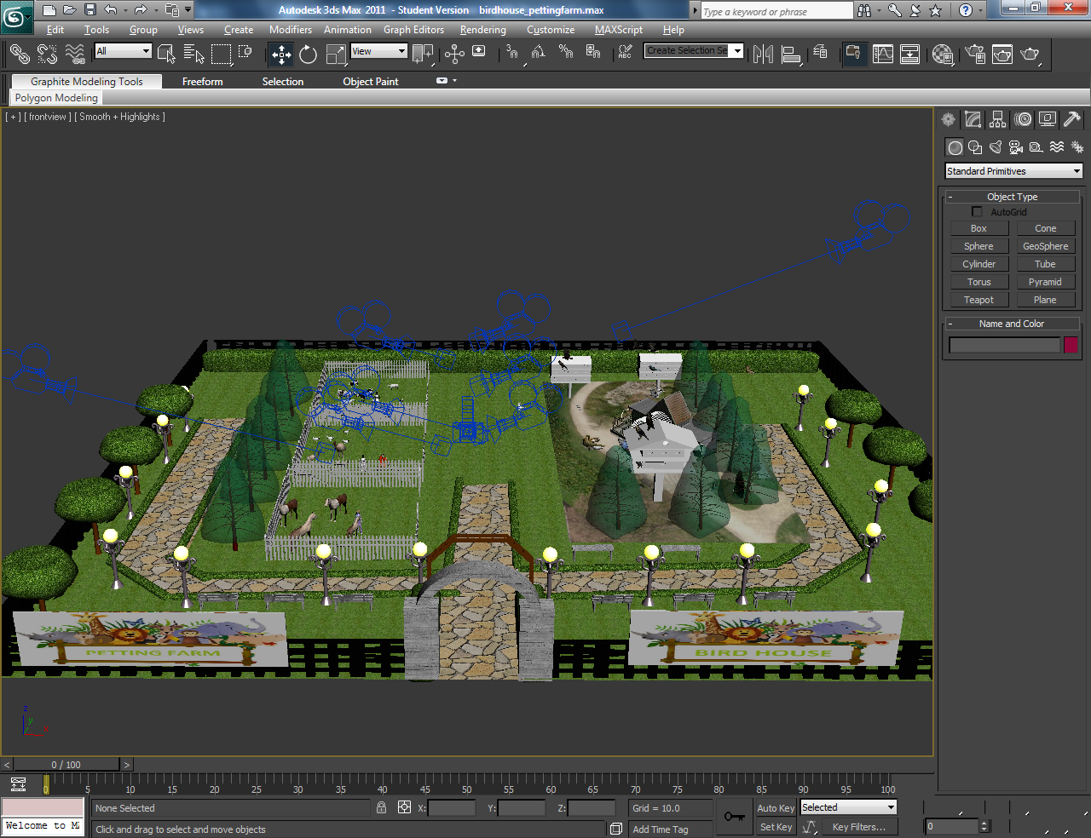
PETTING FARM & BIRD HOUSE

Slide 15
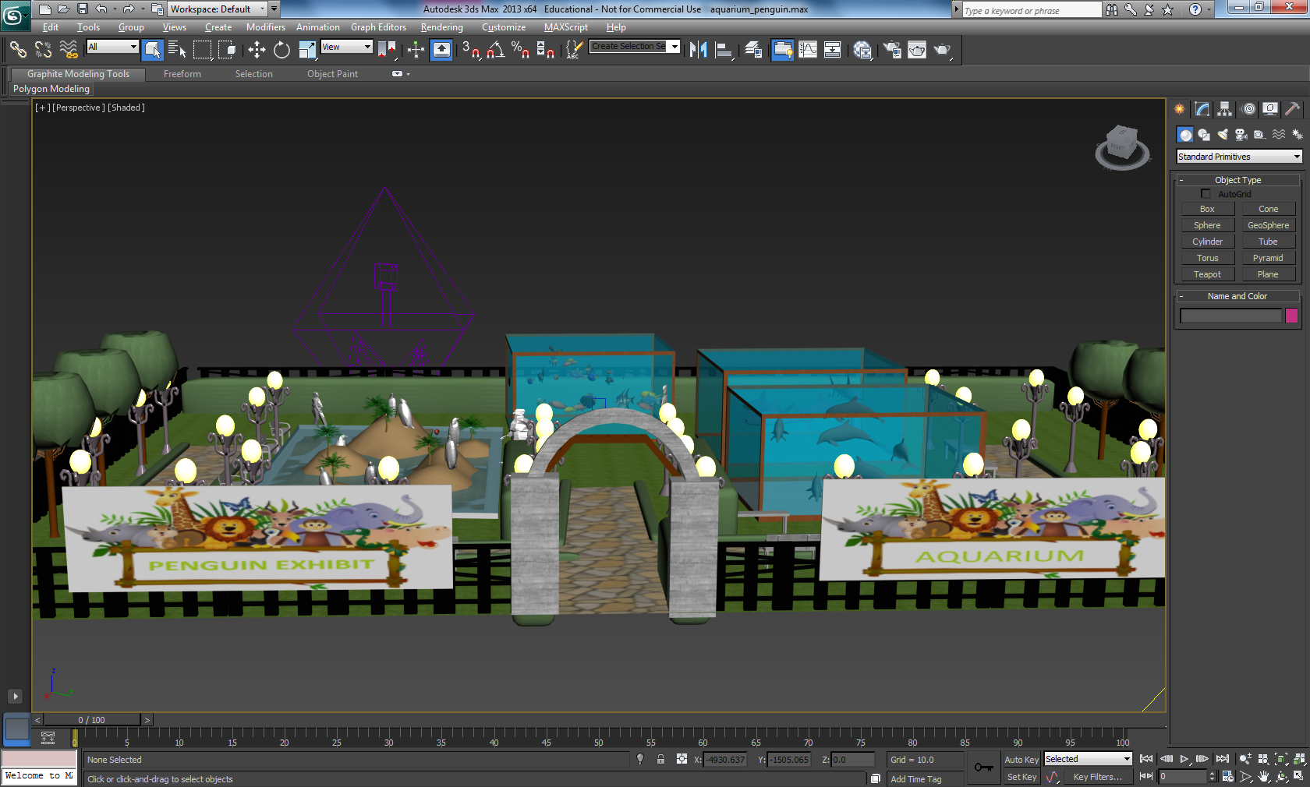
AQUARIUM AND PENGUIN EXHIBIT

Slide 16
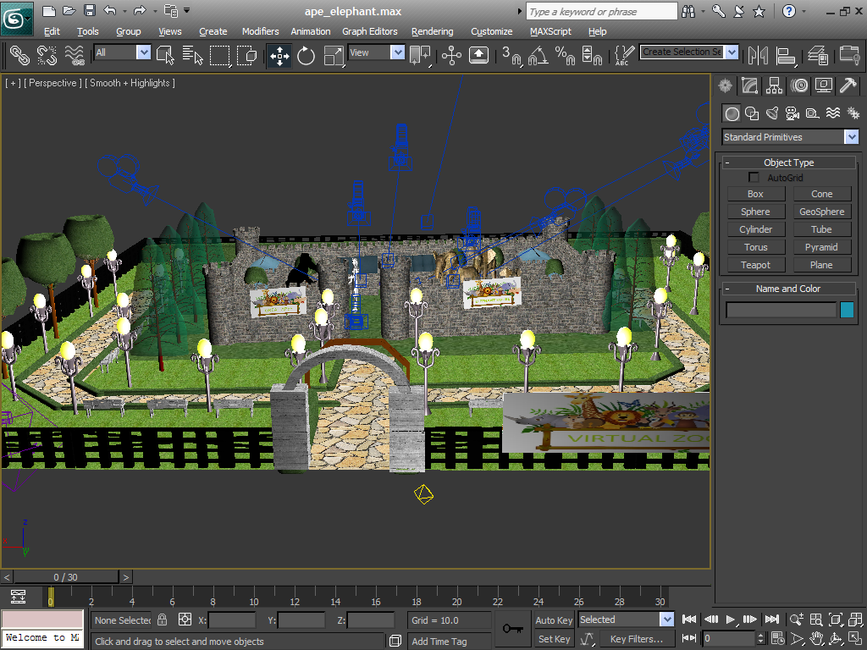
APE AND ELEPHANT HOUSE

Slide 17
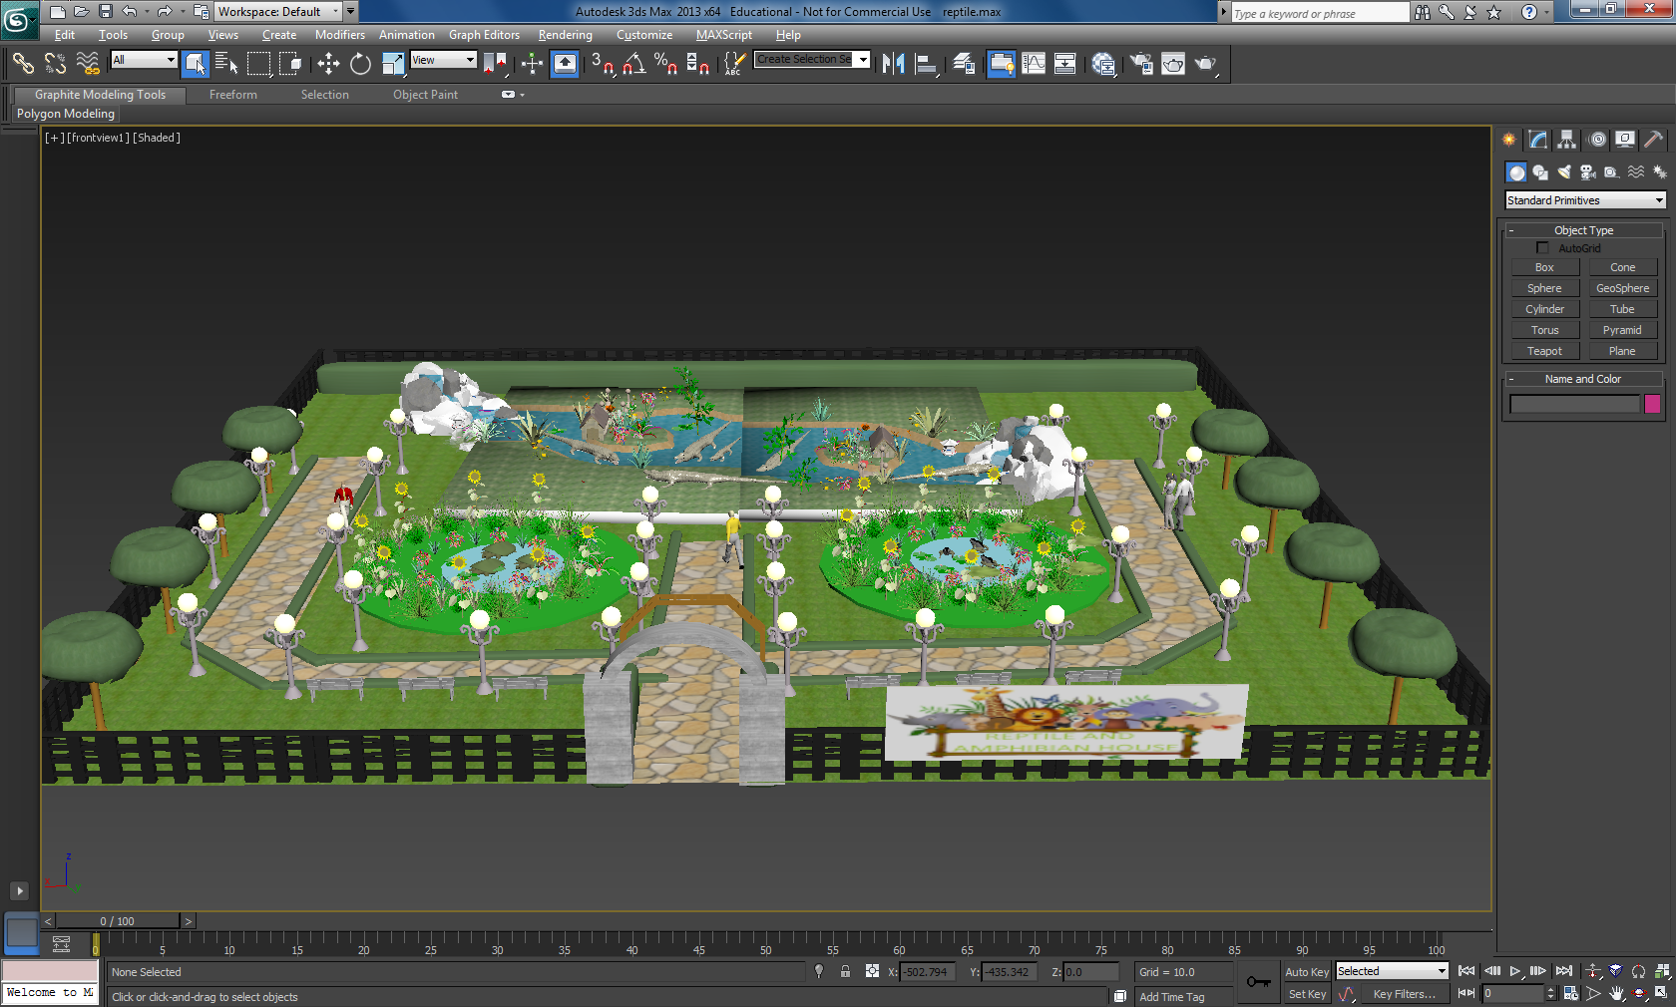
REPTILE AND AMPHIBIAN HOUSE

Slide 18
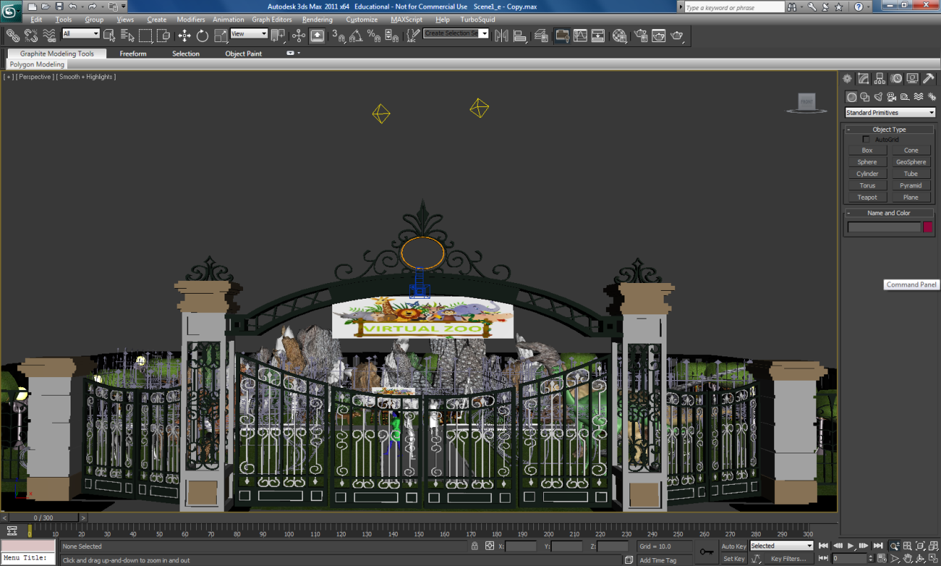
ENTRANCE

Slide 19
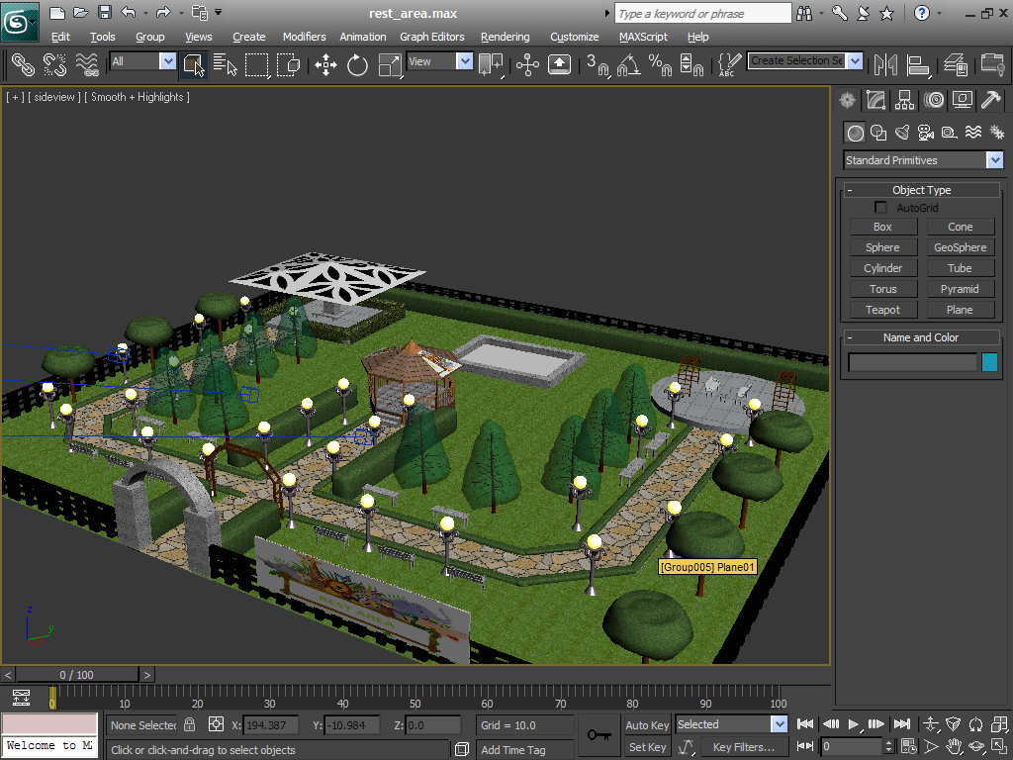
REST AREA

